Slide 1









Whiteboardmaths.com
7
2
1
5
© 2004 All rights reserved

Slide 2
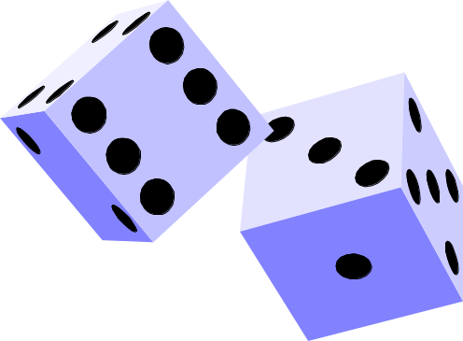
Averages (The Mean)
The mean is also known as the common average. To find the mean value of a set of data you add up all the data values then divide by how many there are. The range is a measure of spread and is the largest data value – the smallest data value.
Example 1. Two dice were thrown 10 times and their scores were added together and recorded. Find the mean and range for this data.
7, 5, 2, 7, 6, 12, 10, 4, 8, 9
Mean = 7 + 5 + 2 + 7 + 6 + 12 + 10 + 4 + 8 + 9
10
= 70
10
= 7
Range = 12 – 2 = 10

Slide 3



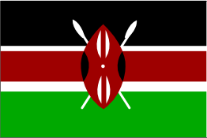



Averages (The Mean)
The mean is also known as the common average. To find the mean value of a set of data you add up all the data values then divide by how many there are. The range is a measure of spread and is the largest data value – the smallest data value.
Example 2. This data shows the populations in millions of a random sample of 12 countries. Find the mean population and range.
3.6, 5.8, 57.5, 14.3, 2.5, 125.6, 5.8, 10.5, 16.8, 33.1, 4.6, 5.2
Mean = 3.6+5.8+57.5+14.3+2.5+125.6+5.8+10.5+16.8+33.1+4.6+5.2
12
= 285.3
= 23.78 million people.
12
Range = 125.6 – 2.5 = 123.1 million people

Slide 4

Averages (The Mode)
The mode is the data value that occurs most frequently
Example 1. The number of matches in a random sample of 14 boxes were counted and the results are recorded below. Find the mode of the data.
48, 49, 52, 50, 51, 49, 49, 55, 47, 48, 50, 51, 50, 50,
Mode = 50 (as it occurs more often than the other numbers).

Slide 5
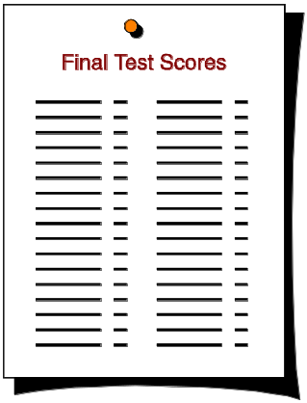

Averages (The Mode)
The mode is the data value that occurs most frequently
Example 2. Twenty people sat a maths test. Their marks out of 10 are recorded below. Find the modal mark for the test.
2, 5, 9, 3, 7, 6, 8, 6, 10, 4,
3, 2, 0, 9, 5, 1, 8, 6, 1, 5
Mode = 5 and 6

Slide 6
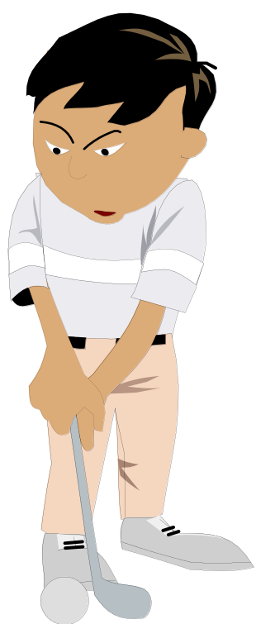
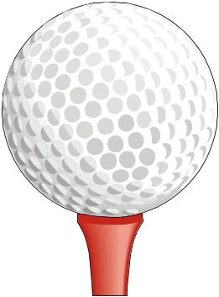
Averages (The Median)
The median is the middle value of a set of data once the data has been ordered.
Example 1. Robert hit 11 balls at Grimsby driving range. The recorded distances of his drives, measured in yards, are given below. Find the median distance for his drives.
85, 125, 130, 65, 100, 70, 75, 50, 140, 95, 70
50, 65, 70, 70, 75, 85, 95, 100, 125, 130, 140
Single middle value
Ordered data
Median drive = 85 yards

Slide 7
Averages (The Median)
The median is the middle value of a set of data once the data has been ordered.
Example 1. Robert hit 12 balls at Grimsby driving range. The recorded distances of his drives, measured in yards, are given below. Find the median distance for his drives.
85, 125, 130, 65, 100, 70, 75, 50, 140, 135, 95, 70
50, 65, 70, 70, 75, 85, 95, 100, 125, 130, 135, 140
Two middle values so take the mean.
Ordered data
Median drive = 90 yards

